Slide 1

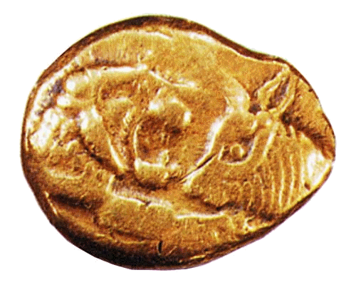
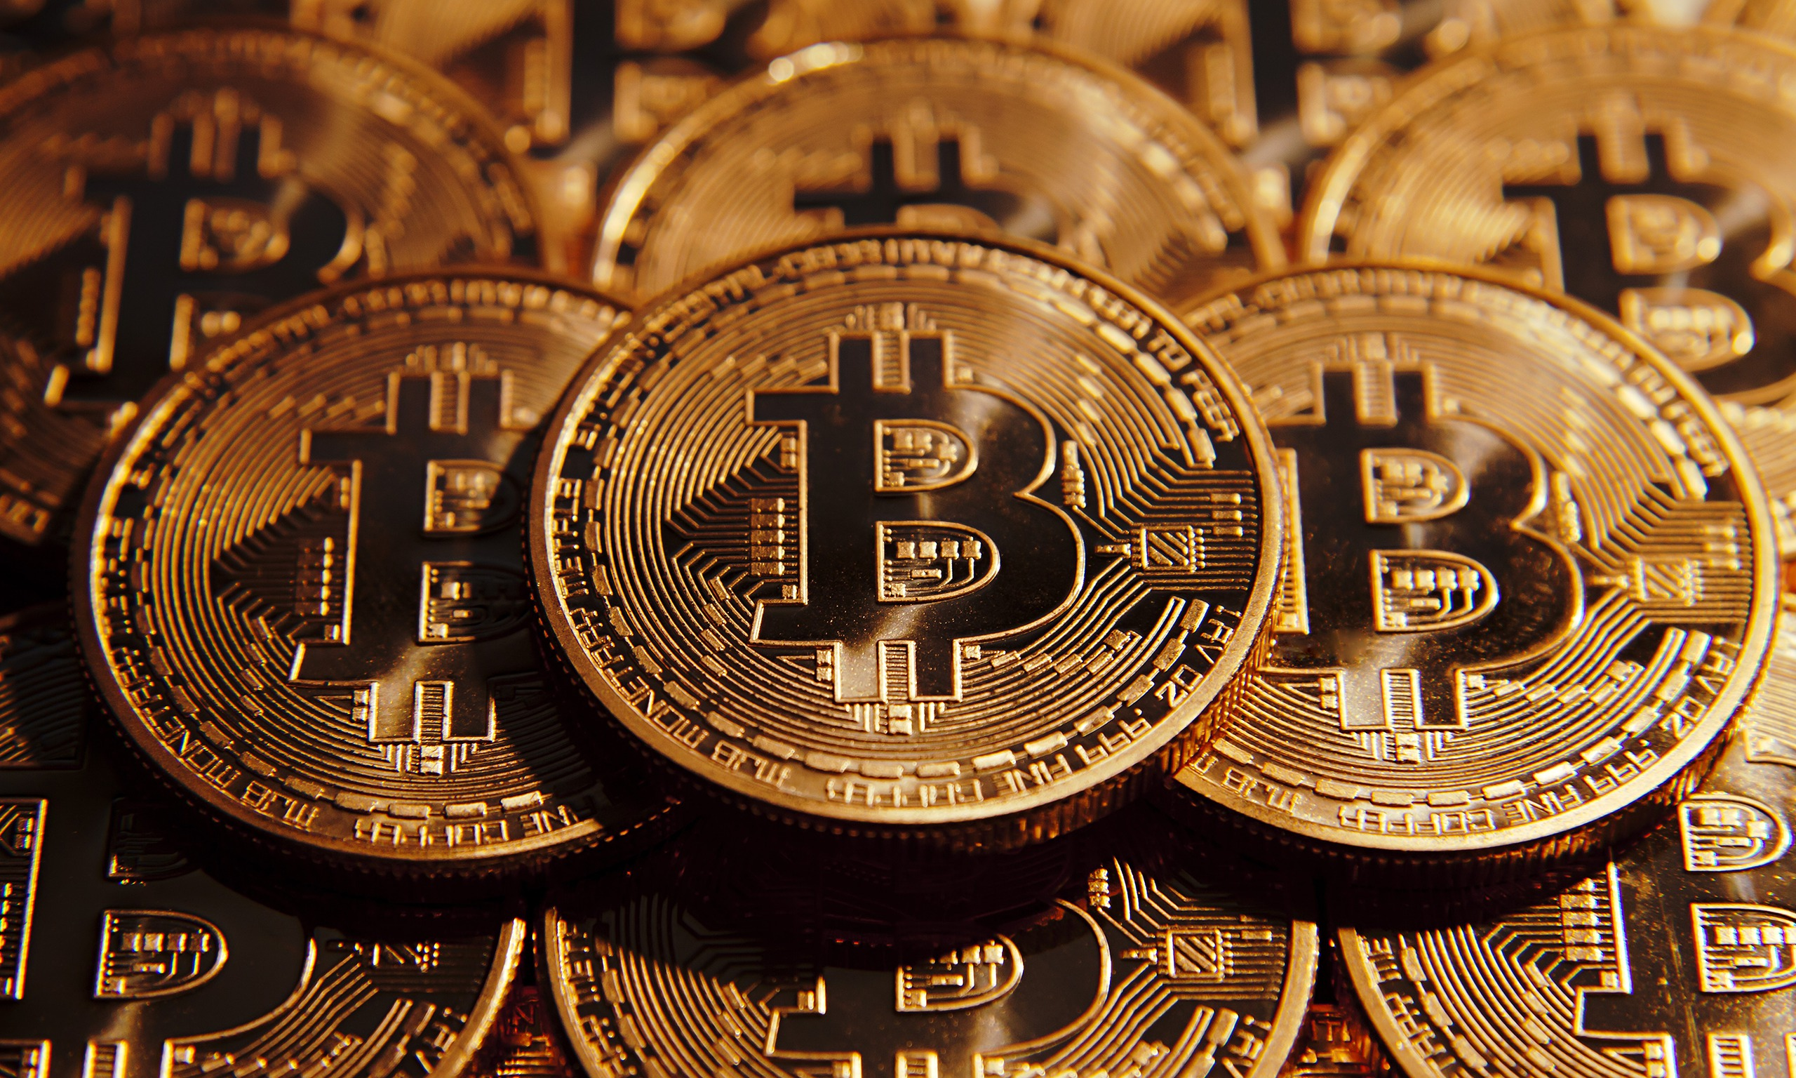
Evolution of money
BIGOT Kévin
DURANDO Adrian

Slide 2
